Slide 1
Floorplanning-2

Slide 2
Hierarchical Bottom up approach
Modules are represented as a graph where edges represent the connectivity of modules
Modules with high connectivity are clustered together
(limiting the number in each cluster to some level)
An optimal floorplan for each cluster is determined by exhaustive enumeration
The cluster is merged into a larger modules for higher level processing

Slide 3
Hierarchical Bottom up approach: Greedy procedure
a
c
3
2
10
3
10
e
1
b
d
3
Choose the heaviest edge, two modules of this edge are clustered together (restrict the number of each cluster to some d )
Vertices in a cluster are merged and edge weights are summed up accordingly
Repeat the above procedure unless finished

Slide 4
Hierarchical Bottom up approach: Greedy procedure
a
c
3
2
10
3
10
e
1
b
d
3
|
|
e
a
c
e
|
|
b
d
a
b
c
d
The problem: Some lightweight edges may be chosen at some higher levels of hierarchy
The possible solution: Arbitrarily assign a small cluster to a neighboring cluster when its size is too small

Slide 5
Hierarchical Bottom up approach: Greedy procedure
a
c
3
2
10
3
10
e
1
b
d
3
|
a
c
|
|
a
b
c
|
b
d
e
d
e
Assign a small cluster to a neighboring cluster when its size is too small

Slide 6
Cost of Floorplan
Cost is dependent on area and connections
Area can be obtained from dimensions of each cluster
Routing cost= the edge weights multiplied by distance between the centres of clusters

Slide 7
Cost of Floorplan:
Estimating routing cost: an example
a
1
2
c
b
5
a
b
c
b
a
c
distance(a,b)= distance (a,c)= 2.24
distance (b,c)=2
Cost= 2.24 x 2 +2.24 x 1 +2.0 x 5 = 16.72
distance(a,b)= distance (b,c)= 2.24
distance (a,c)=2
Cost= 2.24 x 5 +2.24 x 2 +2.0 x 1 = 17.68

Slide 8
Hierarchical Top Down approach
Partition of the module
Each partition is assigned to a child floorplan
Repeat the above procedure recursively
May result two partitions of incompatible sizes
Top Down and Bottom up approaches may be combined

Slide 9
Floorplanning: Simulated annealing approach
The idea originated from observations of crystal formation
When a material is heated, molecules move around randomly
When it is cooled, it forms the crystal
The above process is executed repeatedly
The annealing process moves from one solution to other
Random moves of molecules is simulated by randomly accepting moves during the initial phases of algorithm
As algorithm proceeds, the temperature decreases
The algorithm accepts a move (v_{i}, v_{j}) if cost (v_{i}) ≤ cost (v_{j})
The best cost among all the solutions are recorded

Slide 10

Floorplanning: Simulated annealing approach

Slide 11
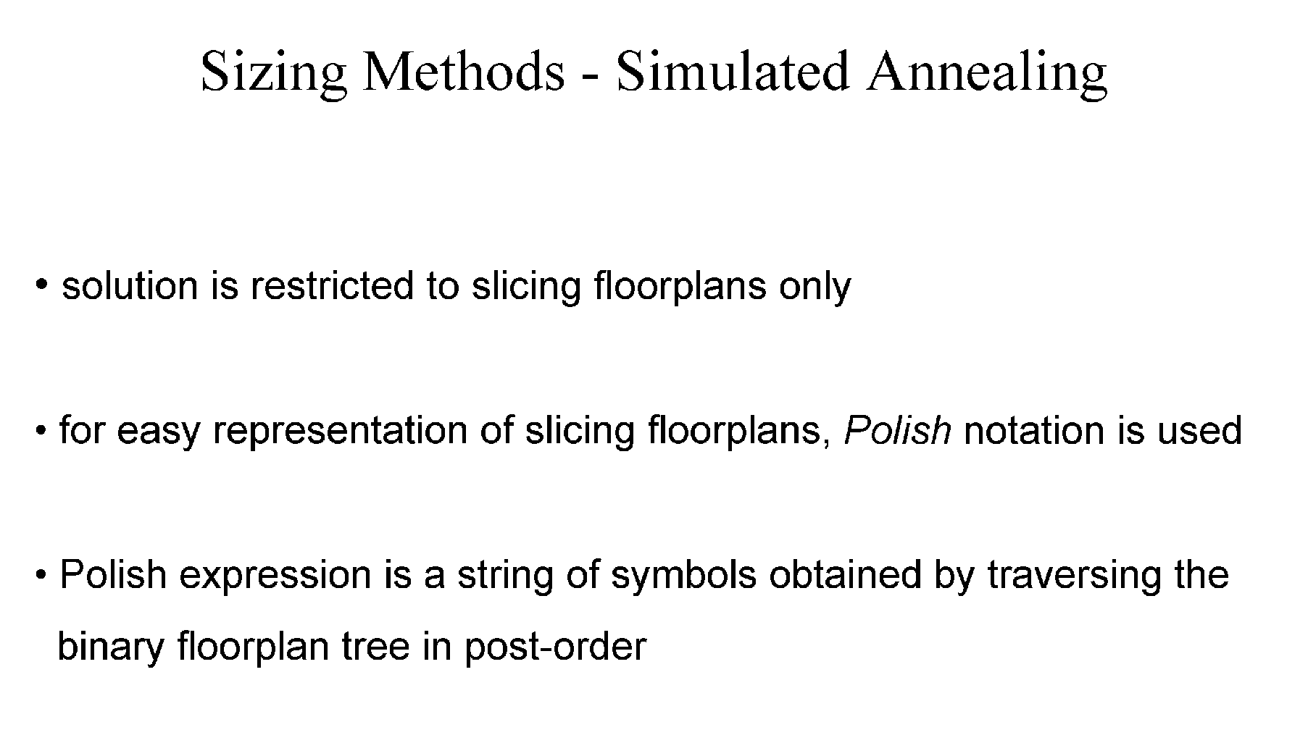
Floorplanning: Simulated annealing approach

Slide 12
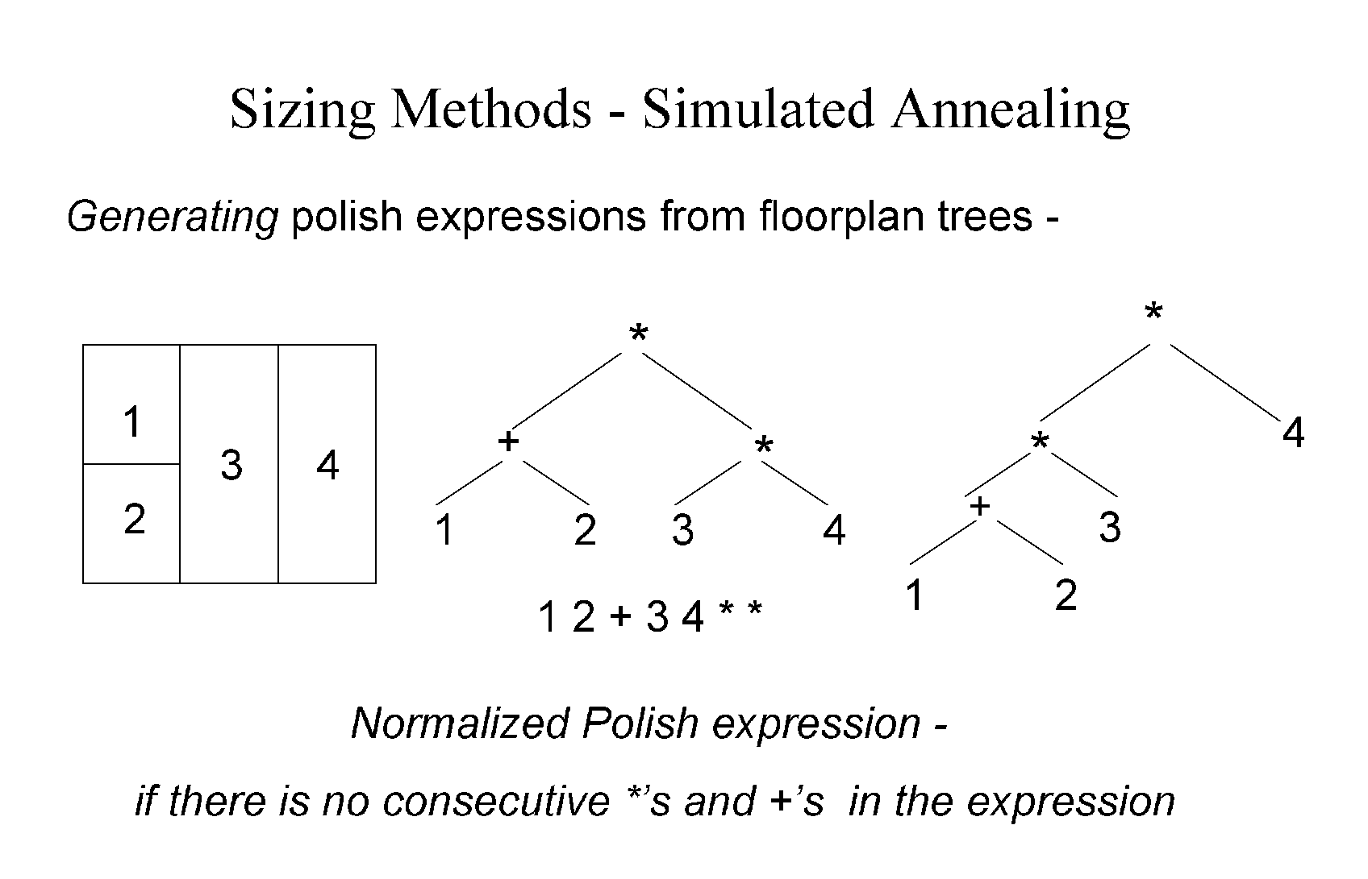
Floorplanning: Simulated annealing approach
12+3*4*

Slide 13
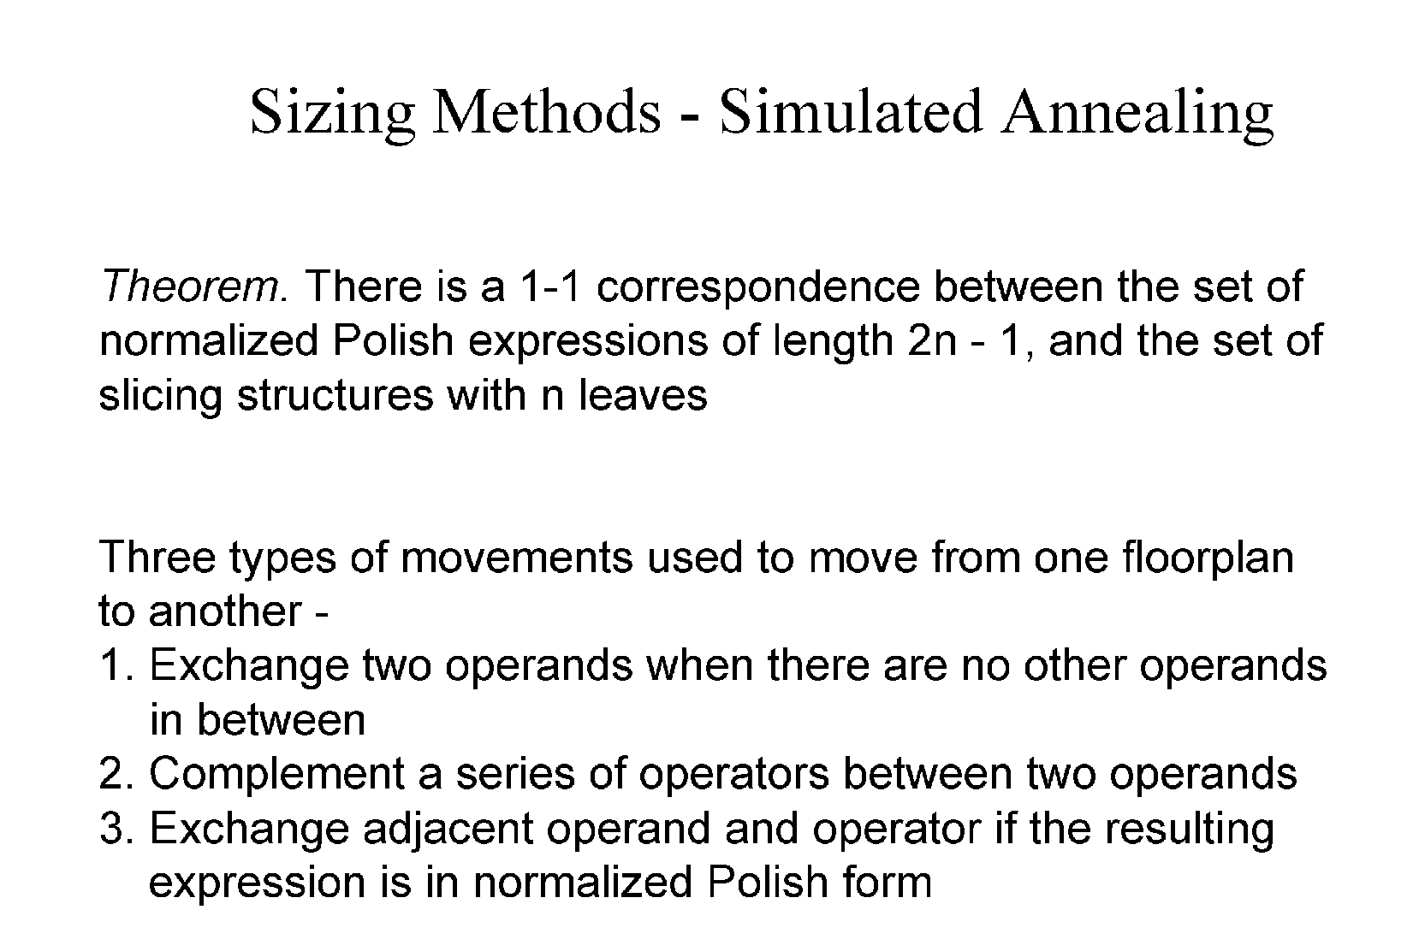
Floorplanning: Simulated annealing approach

Slide 14
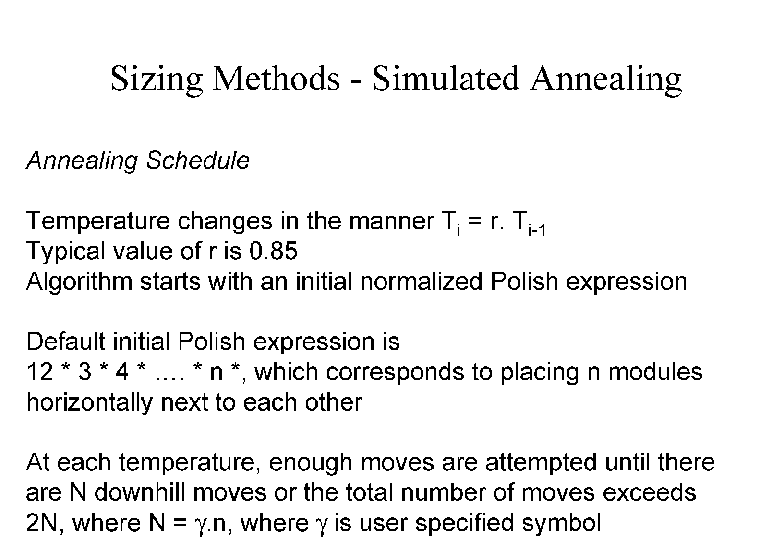
Floorplanning: Simulated annealing approach

Slide 15
Simulated annealing approach
12*4+3*
12*3+4*
Exchange two operands
3
4
4
3
1
2
Complement a series of operators between two operands
1
2
12+3+4*
3
12+34+*
Exchange adjacent operator and operand
2
2
4
4
1
1
3

Slide 16
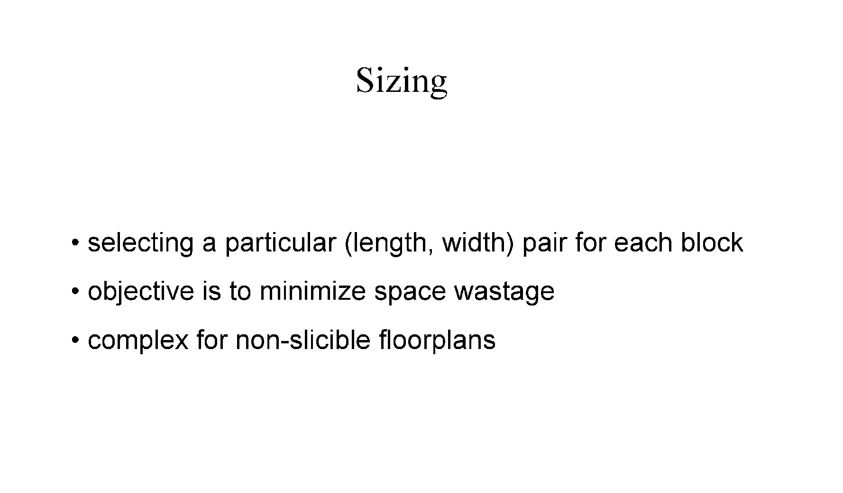

Slide 17
Floorplan sizing problem
The circuit models can usually be implemented in different sizes
Each module has many implementations with different size, speed, and power consumption trade off
The floorplan sizing problem is actual module implementation
If a cell has only one implementation, it is called a fixed cell

Slide 18
Floorplan sizing problem
Assume a fixed cell environment
b
a
2
b
4
a
1
d
d
c
e
3
c
e
2
1
3
4
Floorplan
Maximal vertical segments
Horizontal dependency graph
Horizontal dependency graph:
- A directed acyclic graph
- The length of each edge is the width of the corresponding module in the floorplan
- The longest path from leftmost to rightmost segment is the minimum width of the chip
The height of the chip can be determined by vertical dependency graph

Slide 19
Hierarchical Floorplan Sizing
Consider variable cells on a sliceable floorplan
Given:
A sliceable floorplan F, and for each module M_{i}, a set of possible implementations of the module, where each implementation is described by a pair of real numbers (w_{k}, h_{k}) representing width and height of module
If a module has the realizations (w₁, h₁), (w₂, h₂), (w₃, h₃), ……….., the realizations of are sorted in a manner such that w_{p} < w_{q} and h_{p}> h_{q} for all p < q
For w_{p} <w_{q} if h_{p} ≮h_{q}, exclude (w_{q}, h_{q}) from the list
If a module M_{i} has si realizations, then
w₁< w₂ < w₃,……… <w_{si}, and
h₁> h₂ > h₃,……… >h_{si},

Slide 20
Hierarchical Floorplan Sizing
v
Lemma: Given two subfloorplans corresponding to two subtrees of a node v, one with t and other with s nonredundant implementations, then v has at most s+t-1 nonredundant realizations
L
R
Procedure vertical node sizing
Input: Two sorted lists L= {(a₁,b₁), (a₂,b₂), …….,(a_{s},b_{s})}, and R= {(x₁,y₁), (x₂,y₂), ……….., (x_{t},y_{t})}, where a_{i}<a_{j}, b_{i}>b_{j}, x_{i},<x_{j}, y_{i}>y_{j} for all i < j
Output: A sorted list H= {(c₁,d₁), (c₂,d₂), …….,(c_{u},d_{u})}, where c_{i}<c_{j}, d_{i}>d_{j}, for all i < j
H= Ø, i=1, j=1, k=1
while (i ≤s) and (j≤ t) do
(c_{k}, d_{k})= (a_{i}+ x_{j}, max(b_{i}, y_{j}); H= H ⋃(c_{k}, d_{k}); k=k+1
if max(b_{i}, y_{j})= b_{i}, then i=i+1;
if max(b_{i}, y_{j})= y_{j}, then j=j+1;

Slide 21
Hierarchical Floorplan Sizing: Algorithm
Input: A binary tree corresponding to floorplan with leave nodes representing the modules
Output: Complete floorplan
From each leaf node traverse the tree up to root
by vertical node sizing procedure
The sizing algorithm runs in O(dn) time, where n is the number of modules and d is the height of the the slicing tree
For a balanced binary tree, d= logn
In the worst case, d=n

Slide 22
Linear Programming Technique
Nonhierarchical floorplan sizing method
No restriction on the organization of modules
Notation
(w_{i},h_{i}) : width and height of module M_{i}
(x_{i},y_{i}) : coordinates of the lower left corner of module M_{i}
(x,y) : width and height of the final floorplan
(a_{i},b_{i}) : min and max values of the aspect ratio w_{i}/h_{i} of module M_{i}
For any module M_{i}, a_{i}≤ w_{i}/h_{i} ≤ b_{i}
Usually, a_{i}= 1/b_{i}
The solution is to find (x_{i}, y_{i}, w_{i}, h_{i}) such that all constraints are satisfied and xy is minimized

Slide 23
Linear Programming Technique: Constraints
Nonoverlap constraint
x_{i}+w_{i} ≤ x_{j} (M_{j} is to the right of M_{i}), or
x_{i}-w_{j} ≥ x_{j} (M_{j} is to the left of M_{i}), or
y_{i}+h_{i} ≤ y_{j} (M_{j} is to the above of M_{i}), or
y_{i}-h_{j} ≥ y_{j} (M_{j} is to the below of M_{i})
At least one of the above constraints must be satisfied
For each pair (M_{i} , M_{j}), p_{ij} (0 or 1) and q_{ij} (0 or 1) are introduced
W and H = upper bounds of the width and height of feasible solution region
x_{i}+w_{i} ≤ x_{j} + W(p_{ij} + q_{ij})
x_{i}-w_{j} ≥ x_{j} + W(1- p_{ij} + q_{ij})
y_{i}+h_{i} ≤ y_{j} + H(1+ p_{ij} - q_{ij})
y_{i}-h_{j} ≥ y_{j}+ H(2- p_{ij} - q_{ij})
The above system of inequalities solves the overlap constraint

Slide 24
Linear Programming Technique: Constraints
Module size constraint
Consider that the blocks are not of fixed sizes
For each module M_{i}, a lower bound on area A_{i} and aspect ratios a_{i},b_{i} are given, s.t., w_{i}h_{i} ≥ A_{i} , and a_{i} ≤ w_{i} /h_{i} ≤ b_{i}
w_{min} =√A_{i}a_{i,} w_{max} =√A_{i}b_{i}, h_{min} =√A_{i}/b_{i} , h_{max} =√A_{i}/a_{i}
h
h_{i}=Δ_{i}w_{i} + c_{i}
Δ_{i}-= (h_{max} - h_{min} ) /(w_{min} - w_{max})
c_{i}=h_{max} - Δ_{i} w_{min}
h_{max}
h_{i}=Δ_{i}w_{i} + c_{i}
The ineuqualities to be solved
x_{i}+w_{i} ≤ x_{j} + W(p_{ij} + q_{ij})
x_{i}-w_{j} ≥ x_{j} + W(1- p_{ij} + q_{ij})
y_{i}+ Δ_{i}w_{i} +c_{i} ≤ y_{j} + H(1+ p_{ij} - q_{ij})
y_{i}- Δ_{j}w_{j} -c_{j} ≥ y_{j}+ H(2- p_{ij} - q_{ij})
w_{i}h_{i} = A_{i}
h_{min}
w
w_{min}
w_{max}

Slide 25
The Cost function
The function to be minimized = the total area of the floorplan A= xy
Let us fix the width W and minimize the height of floorplan
min y
x_{i}+w_{i} ≤ W
y ≥ y_{i}+h_{i}

Slide 26
Complete LP formulation
The function to be minimized = the total area of the floorplan A= xy
Let us fix the width W and minimize the height of floorplan
min y
x_{i}, w_{i} , y_{i} ≥ 0
p_{ij}, q_{ij} =0 or 1
x_{i}+w_{i} ≤ W
y ≥ y_{i}+h_{i}
x_{i}+w_{i} ≤ x_{j} + W(p_{ij} + q_{ij})
x_{i}-w_{j} ≥ x_{j} + W(1- p_{ij} + q_{ij})
y_{i}+ Δ_{i}w_{i} +c_{i} ≤ y_{j} + H(1+ p_{ij} - q_{ij})
y_{i}- Δ_{j}w_{j} -c_{j} ≥ y_{j}+ H(2- p_{ij} - q_{ij})

Slide 27
